Slide 1
Film Terminology
Film and Literature
Mrs. Thomas
Austin Catholic High School
2015-2016

Slide 2
The building block of all filmmaking…
Shot
an image that is seen on-screen until it is replaced by another image through some kind of editing technique

Slide 3
Framing
how an object(s) will be positioned within the shot
Long shot
Close up
Medium shot

Slide 4
Long shot
Can show a person’s entire body
Can establish a scene by showing a skyline for example
Can show distance or separation between characters
Can allow the viewer to choose where to look

Slide 5
Long Shot from King Kong -1933

Slide 6
Long shot from The Color Purple

Slide 7
Long shot from The Lion King

Slide 8
Close Up
Object or subject takes up 80% of the screen and appears very large
Can be intimate and revealing, like a facial expression or an important clue in a detective story
The director forces the viewer to look

Slide 9
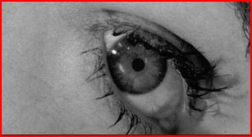
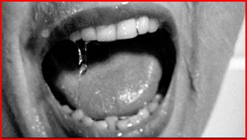
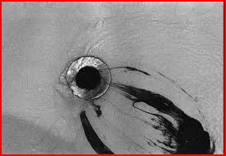
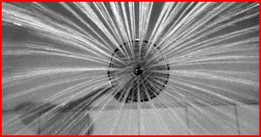
Close up from Psycho

Slide 10
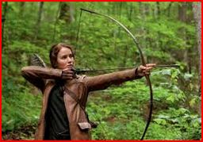
Medium Shot
Neutral shot
Like television
Medium shot from The Hunger Games

Slide 11
Variations on shots
Extreme close up
¾ medium shot, etc.
Classic Hollywood Conventional Shot
Starts long-to medium-to close up
Examples of basic shot types

Slide 12
Focus
Soft focus
Slightly blurred
Can lighten the mood (romantic comedy)
Can communicate uncertainty
Rack focus
Brings the background or foreground suddenly into focus to draw attention
Deep focus
The foreground and background are both in focus

Slide 13
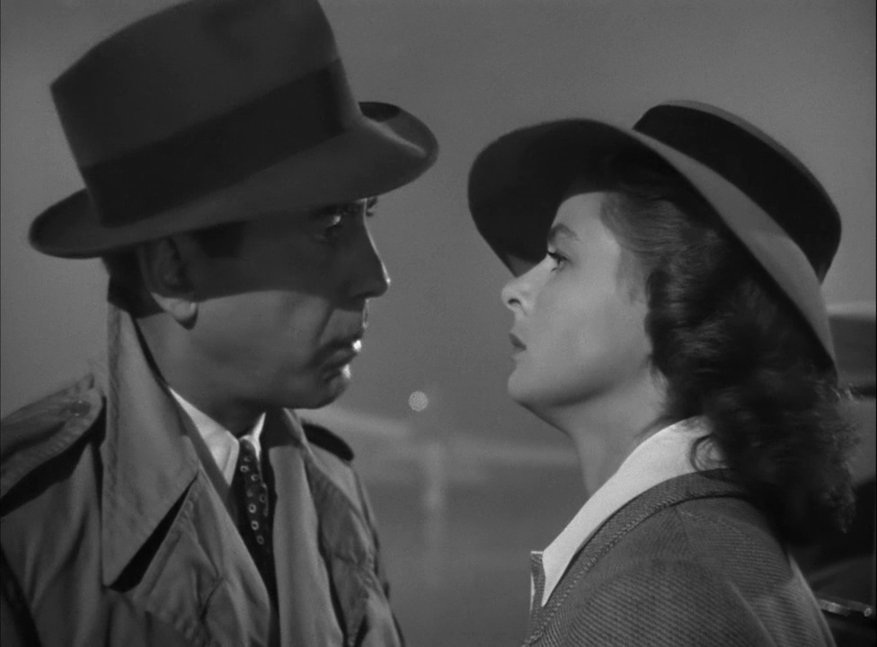
Soft focus
Casablanca final scene with Humphrey Bogart and Ingrid Bergman (1942)

Slide 14
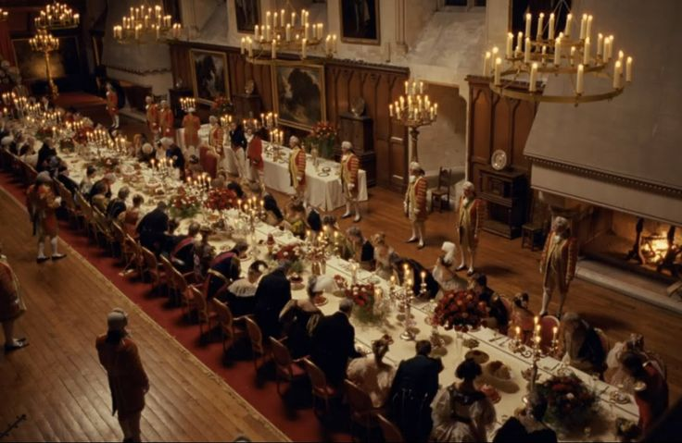
Rack focus
Young Victoria (2009)

Slide 15
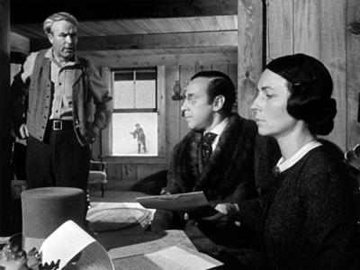
Deep focus
Citizen Kane (1941)

Slide 16
Angles
Where the camera is placed in relation to its subject
Low angle
High angle
Eye level
Dutch angle

Slide 17
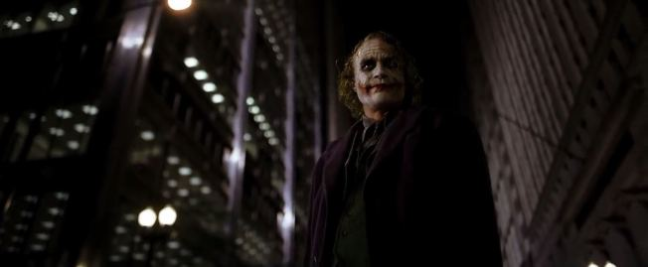
Low angle
Makes the subject appear huge, powerful, dominating, and in control
Low angle from The Dark Knight

Slide 18
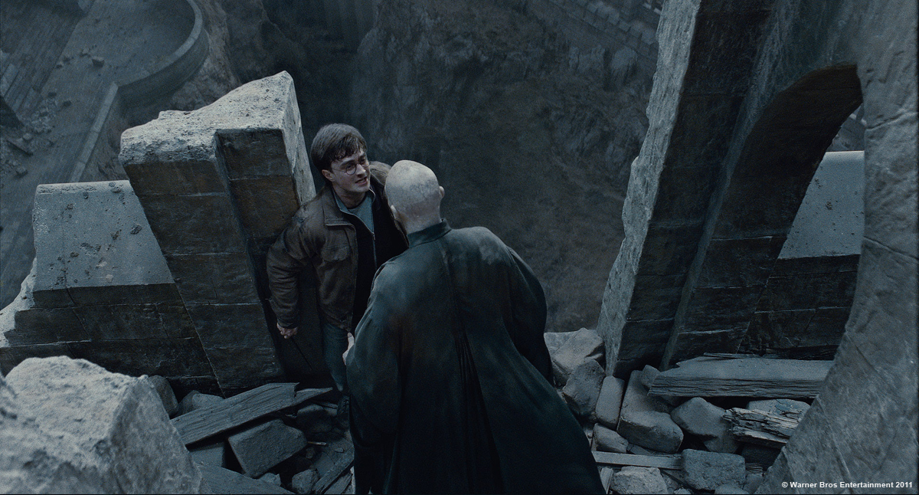
High Angle
Makes the subject appear small, weak, powerless, trapped, etc.

Slide 19
Eye Level
Neutral shot
Can imply equality
Or
Can demonstrate growing strength or confidence if it follows some high-angle shots

Slide 20
Dutch Angle
The camera is “canted” or tiled slightly
Often used to imply evil, uncertainty, tension …. Something is just not right.
The Twilight Zone

Slide 21
Camera Movements
Pan – camera moves on a horizontal axis
Tilt – camera moves on a vertical axis
Zoom – focal length of the camera changes; object grows/shrinks in the frame; object appears to move
Tracking/Dolly Shots – the camera moves

Slide 22
Camera Movement Examples
The Shining – Dolly shot
Jaws – fast zoom
Other examples – pan, low angle, crane up, Dutch angle, frantic zoom, POV,

Slide 23
Lighting
Key light – principle source of light in a scene
Low key light – shadows, suspense, and suspicion
High key light – scene is flooded with light, bright, open-looking

Slide 24
Effects of lighting
Neutral lighting – doesn’t say much
Bottom/side lighting – shadows mean evil, deception, moral ambiguity
Front lighting – halo effect=innocence

Slide 25
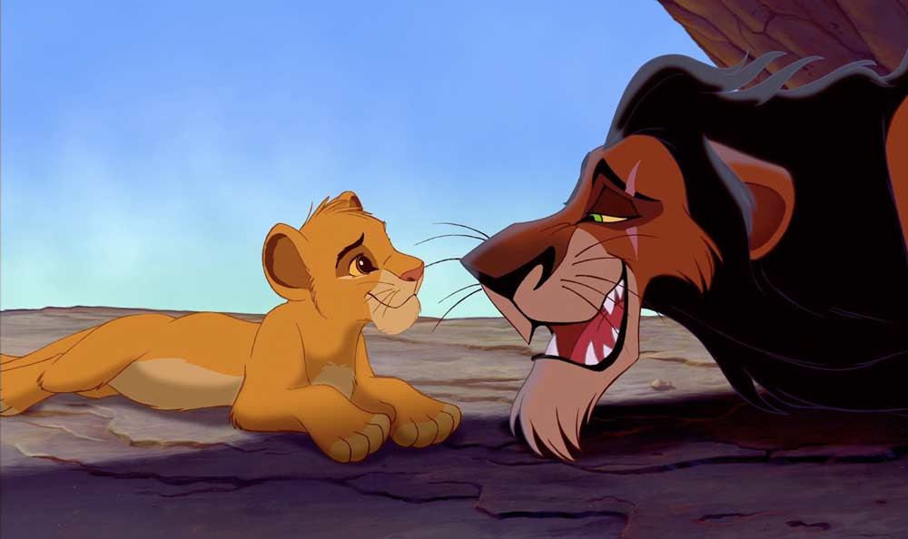
Who’s the villain?

Slide 26
Sound
Diegetic sound – logically heard by characters
Nondiegetic sound – intended only for the audience to hear
Internal diegetic sound – only one character hears the sound; e.g.. character’s thoughts

Slide 27
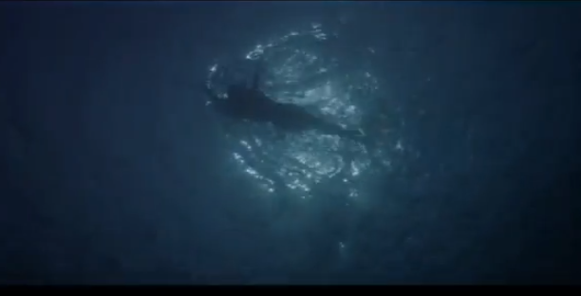
“duh-duhn…duh-duhn…
What can the characters hear?
Jaws

Slide 28
Editing
How the director chooses to move from one shot to another
Cut – most common. The film is literally cut and attached to another piece resulting in a split second of black, like a blink.

Slide 29
Other ways to edit shots
Fade – image slowly fades to black and a new image fades in. Not realistic. Shows time passing

Slide 30
Other ways to edit shots, cont.
Dissolve – image fades to next image, often to show a connection

Slide 31
Other ways to edit shots, cont
Crosscut – switches back and forth between two scenes
The Godfather (1972)

Slide 32
Other ways to edit shots, cont
Flash-back/flash-forward – useful for foreshadowing

Slide 33
Other ways to edit shots, cont
Eye-line match/Point of view POV – shot from a character’s perspective
Minion POV example

Slide 34
Editing rhythm and duration
How long is each shot allowed to stay on the screen?
Average Hollywood style take = 8-10 seconds
Long takes can be 20-30 seconds or many minutes in length.

Slide 35
Examples of editing rhythm
How do the long takes or short cuts create the mood of the clip?
Goodfellas – Long take
Snatch and other examples -- jump cut

Slide 36
Mise-en-scene
A theater concept…
Everything that appears on stage (or in a scene)…
Sets, costumes, lighting, acting…
A complex concept that requires the viewer to consider all the elements chosen by the director that make up the scene or whole film.

Slide 37
Mise-en-scene, continued
The Pursuit of Happyness with Will Smith
What choices did the director make in this scene?

Slide 38
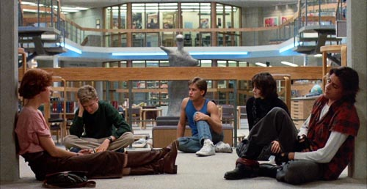
Mise-en-scene, continued
What choices did the director make in this scene?

Slide 39
North by Northwest (Alfred Hitchcock, 1958)
Cary Grant plays Roger Thornhill, who has been falsely accused of murder and instructed by those who have set him up to come to a deserted field to meet someone named “Kaplan”.
Cornfield scene beginning

Slide 40
North by Northwest, continued
How does Hitchcock make this scene suspenseful?
How does he show Thornhill’s vulnerability?
Why does he use diegetic sound in this clip?

Slide 41
Apocalypse Now opening scene (1979) Francis Ford Coppola
What is real and what is imagined?
Watch for …
the wide shot of the jungle
Nondiegetic music – The Doors The End
Silent bombs falling at the line “This is the end, my beautiful friend”
Martin Sheen’s face and jungle overlay
Ceiling fan or helicopter?
Voice over
What is diegetic? Nondiegetic? Internal diegetic?

Slide 42
Analyze the scene…
If the director’s aim was to create a sense of confusion and/or displacement, what elements of the mise-en-scene helped him achieve this?

