Slide 1
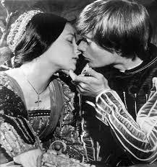
Characteristics of Shakespearean Tragedy

Slide 2
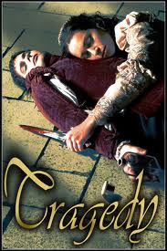
Tragedy…
A drama that ends in catastrophe – most often death– for the main characters.

Slide 3
Tragic hero…
Is the protagonist
Fails or dies because of a character flaw or a cruel twist of fate
Often has a high rank or status
Shows strength while facing his or her destiny

Slide 4
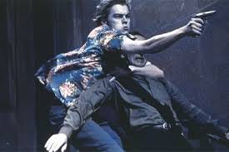
Antagonist…
Is the force working against the protagonist
Can be another character, a group of characters, or something nonhuman (nature, society)

Slide 5
Foil…
A character whose personality and attitude contrast sharply with those of another character
Highlights both characters’ traits – for example, a timid character can make a talkative one seem even chattier

Slide 6
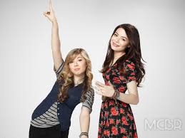
Foil
Sam and Carly are examples of dramatic foils.

Slide 7
Soliloquy…
A speech given by a character alone on stage
Lets the audience know what the character is thinking or feeling

Slide 8
Aside…
A character’s remark, either to the audience or to another character, that others on stage do not hear
Reveals the character’s private thoughts

Slide 9
Dramatic irony…
Is when the audience knows more than the characters – for example the audience is aware of Romeo and Juliet’s tragic demise long before the characters themselves face it
Helps build suspense

Slide 10
Comic Relief…
Is a humorous scene or speech intended to lighten the mood
Serves to heighten the seriousness of the main action by contrast

Slide 11
Blank verse…
Resembles real speech
Unrhymed lines of iambic pentameter

Slide 12
Iambic pentameter…
Iamb = unstressed syllable followed by a stressed syllable
Pentameter = 5 repetitions of the meter
Yet tell me not for I have heard it all.
Here’s much to do with hate but more with love.

Slide 13
Allusion…
A reference within a work, to something that the audience is expected to know.
Examples: Greek and Roman mythology, the Bible, etc.

Slide 14
Sarcasm…
A particularly cutting irony
Generally, sarcasm is the taunting use of praise to mean its opposite – that is to insult someone or something.

Slide 15
Pun…
Jokes that result from multiple word meanings or rhyming sounds.
In Act One, Romeo is depressed. He offers to carry the torch by saying:
“Being but heavy, I will bear the light.”
Heavy= depression
Light=happiness and visual light

